Slide 1

Common Document Functionalities
Philippe Leefsma
Developer Technical Services

Slide 2
Agenda
Documents Types
Working with Documents
Document Settings
iProperties
Lab: iProperties lab
Unit of Measure
Parameters
Lab: UOM lab

Slide 3
Document Types
Unique document types for different types of data.
Part Documents (*.ipt)
Assembly Documents (*.iam)
Drawing Documents (*.idw)
Presentation Documents (*.ipn)
The API represents each document type using a different type of object for each type of document.

Slide 4
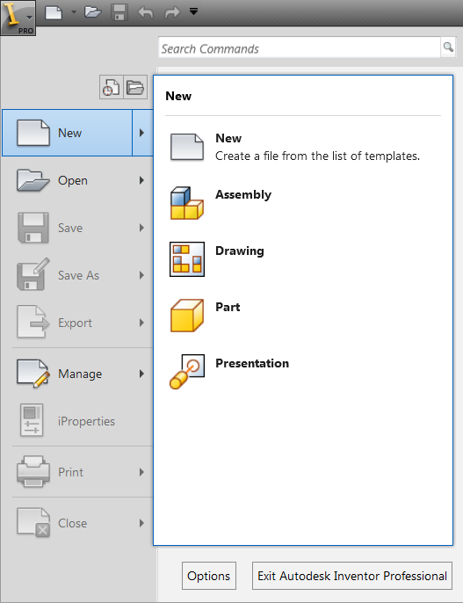
Accessing Documents
Creating new documents
Documents.Add
Opening existing documents
Documents.Open
Accessing open documents
Documents.Item
(Enumerates all documents, including those that have been opened because they’re referenced by another document.)

Slide 5
Templates
The GetTemplateFile method of the FileManager object allows you to get the full path of any specified template.
GetTemplateFile(DocumentType As DocumentTypeEnum, [SystemOfMeasure As SystemOfMeasureEnum = kDefaultSystemOfMeasure], [DraftingStandard As DraftingStandardEnum = kDefault_DraftingStandard], [DocumentSubType]) As String

Slide 6
Opening and Creating Documents
'Opens an existing document
Public Sub OpenDoc()
Dim oDoc As Document
oDoc = _InvApplication.Documents.Open("C:\Temp\Part1.ipt")
End Sub
'Creates a new document using a specified template
Public Sub CreateDoc()
Dim oDoc As PartDocument
oDoc = _InvApplication.Documents.Add(DocumentTypeEnum.kPartDocumentObject, _
_InvApplication.FileManager.GetTemplateFile(DocumentTypeEnum.kPartDocumentObject), _
True)
End Sub
'Creates a new document using internally defined template
'(Can be done in the UI by using Ctrl-Shift when creating new document.)
Public Sub CreateDoc2()
Dim oDoc As PartDocument
oDoc = _InvApplication.Documents.Add(DocumentTypeEnum.kPartDocumentObject, , True)
End Sub

Slide 7
Saving Documents
The first time a new document is saved you should use the SaveAs method with the SaveCopyAs flag set to False.
For documents that have been saved to disk you can use the Save method or the SaveAs with the SaveCopyAs flag set to True.
Dim oDoc As PartDocument
oDoc = _InvApplication.Documents.Add(DocumentTypeEnum.kPartDocumentObject)
oDoc.SaveAs("C:\Temp\SaveTest.ipt", False)
oDoc.Save()
oDoc.SaveAs("C:\Temp\SaveTest2.ipt", True)

Slide 8
Closing Documents
Document.Close([SkipSave As Boolean = False])
Using the SkipSave argument you can bypass the dialog asking to save the changes and force the document to close without saving. This is useful in cases where you use a file as a template by opening the file, modifying it in some way, and using SaveCopyAs to save it as a new file. Using this you can close the original without saving and without forcing the user to interact with a dialog.
Documents.CloseAll([UnreferencedOnly As Boolean = False])

Slide 9
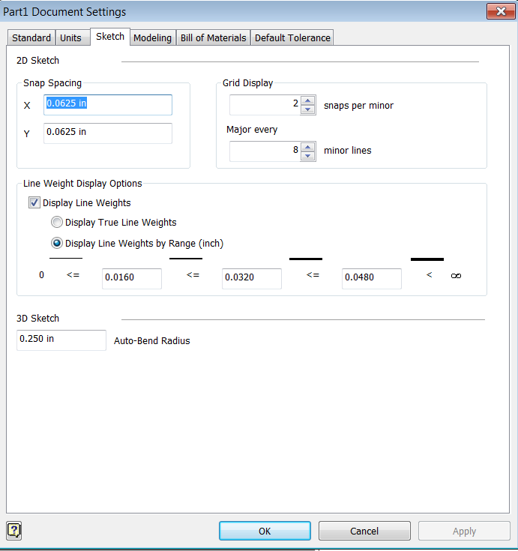
Document Settings
Document settings are exposed from various objects obtained from the document.

Slide 10
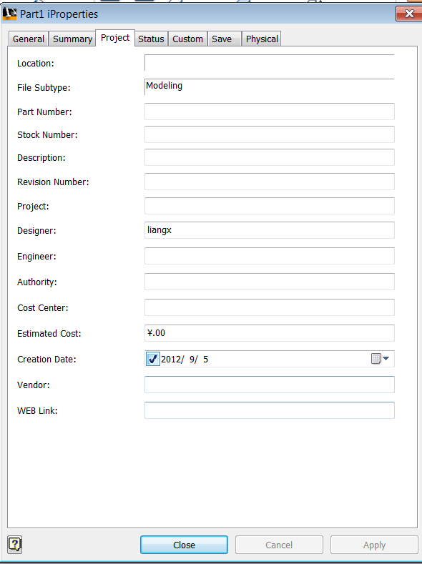
iProperties in the User Interface
iProperties are used to associate information with a document.
Predefined set of properties are available through the iProperties dialog.
End-users can create additional properties using the “Custom” tab of the iProperties dialog.
Are supported by both Inventor and Apprentice.

Slide 11

iProperties – Property Sets
The PropertySets object acts as the container for all of the properties.
Provides access to the individual PropertySet objects using the Item property.

Slide 12
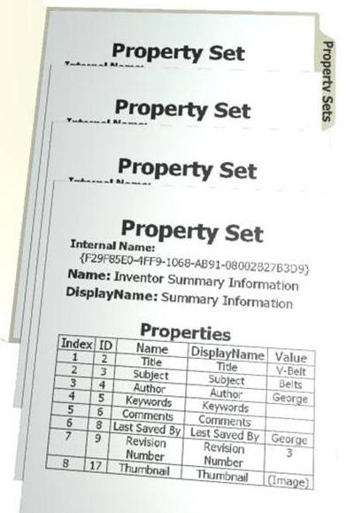
iProperties – Property Set
The PropertySet object contains a group of properties.
Most PropertySet objects roughly correspond to the tabs in the iProperties dialog.
PropertySet objects are identified by:
InternalName (consistent)
Name (consistent)
DisplayName (may change)

Slide 13
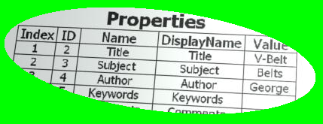
iProperties - Property
Properties are named values.
Property objects are identified by:
ID (consistent)
Name (consistent)
DisplayName (may change)

Slide 14
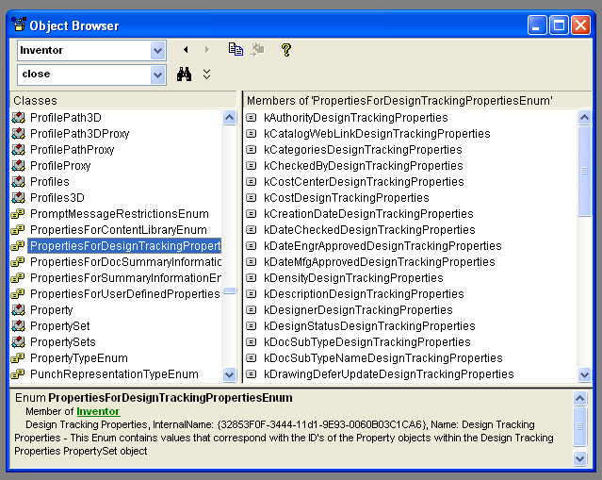
iProperties
Property values are stored internally as Variants. The following types are supported: Integer, Long, Double, String, Date, and Boolean. (With the exception of the thumbnail image which is IPictureDisp.)
InternalNames can be found using the Object Browser and in SDK\Include\PropFMTIDs.h
PropId’s are defined in the various property related enums.

Slide 15
iProperty Names
Name and Internal Name of Inventor defined property sets:
Inventor Summary Information {F29F85E0-4FF9-1068-AB91-08002B27B3D9}
Inventor Document Summary Information {D5CDD502-2E9C-101B-9397-08002B2CF9AE}
Design Tracking Properties {32853F0F-3444-11D1-9E93-0060B03C1CA6}
Inventor User Defined Properties {D5CDD505-2E9C-101B-9397-08002B2CF9AE}

Slide 16
iProperties – Accessing Example
Public Sub iPropAccess()
Dim oDoc As Document
oDoc = _InvApplication.ActiveDocument
' Access a particular property set. In this case the design tracking property set.
Dim oDTProps As PropertySet
oDTProps = oDoc.PropertySets.Item("{32853F0F-3444-11d1-9E93-0060B03C1CA6}")
' Access the same property set using the display name or name. DisplayName is not
' dependable because it can be localized, so the internal name or name is preferred.
oDTProps = oDoc.PropertySets.Item("Design Tracking Properties")
' Get a specific property, in this case the designer property.
Dim oDesignerProp As Inventor.Property
oDesignerProp = oDTProps.ItemByPropId( _
PropertiesForDesignTrackingPropertiesEnum.kDesignerDesignTrackingProperties)
' You can also use the name or display name
' the display name has the problem that it can be changed.
oDesignerProp = oDTProps.Item("Designer")
' Show the display name and value.
Debug.Print(oDesignerProp.DisplayName & " = " & oDesignerProp.Value)
' Change the designer name.
oDesignerProp.Value = "Bill & Ted"
End Sub
Notes:
VB.Net Sample iProperties Dump:
'Sample iProperties Dump:
Public Sub DumpDocProperties()
Dim oDocument As Document
oDocument = _InvApplication.ActiveDocument
Dim oPropertySets As PropertySets
oPropertySets = oDocument.PropertySets
Dim oPropertySet As PropertySet
'Namespace required to avoid conflict with Vb.Net "Property" keyword
Dim oProperty As Inventor.Property
For Each oPropertySet In oPropertySets
Debug.Print(vbCrLf & "----------------- Property Set: " & oPropertySet.Name)
For Each oProperty In oPropertySet
Debug.Print(" - " & oProperty.Name & " [ID:" & oProperty.PropId & "] : " & Space(30 - Len(oProperty.Name)) & oProperty.Expression)
Next
Next
End Sub

Slide 17
iProperties - Creation
Create new property sets.
PropertySets.Add(Name As String, [InternalName]) As PropertySet
Name and InternalName must be unique with respect to other property sets in the document.
Create new properties.
PropertySet.Add(PropValue, [Name], [PropId]) As Property
Properties cannot be added to the predefined sets, except for the custom property set.
The Name and PropId must be unique with respect to other properties in the property set.
The value type can be most Variant types except arrays and objects.
PropertySets and Properties can be created as hidden by using a name that begins with an underscore. These will not be returned by indexing through a collection. They can only be retrieved by asking for them by name.

Slide 18
iProperties - Saving
In Inventor, any changes made to properties are saved when the document is saved.
In Apprentice you need to use “PropertySets.FlushToFile” method.
‘Create Apprentice Application
Dim oApprentice As ApprenticeServerComponent
oApprentice = New ApprenticeServerComponent
‘Open a document
Dim oDoc As ApprenticeServerDocument
oDoc = oApprentice.Open("C:\Temp\Part.ipt")
‘change a property
Dimm oPropSet As PropertySet
oPropSet = oDoc.PropertySets("Design Tracking Properties")
oPropSet.Item("Designer").Value = "Fred Astair"
‘save the change
oDoc.PropertySets.FlushToFile()

Slide 19
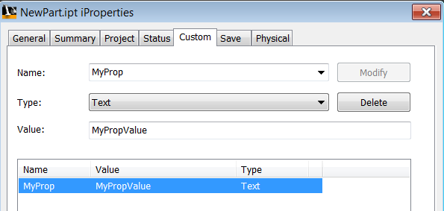
Lab: iProperties
Write a .Net program that performs the following steps:
Creates a new part document.
Edits the value of the author property to contain your name.
Creates a new custom (user-defined) property called “Supplier” that contains the value “Parts R Us”.
Save the document to “C:\Temp\NewPart.ipt”
Close the document.

Slide 20
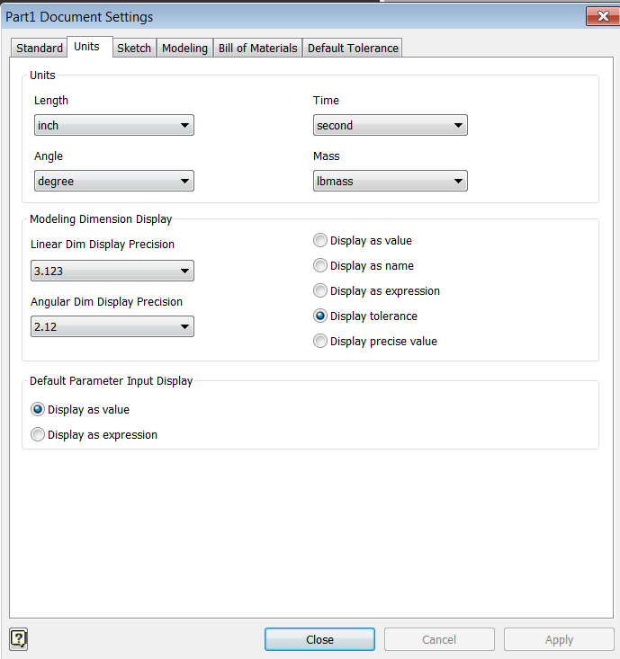
Units of Measure
All Inventor documents use the same internal units.
Length: Centimeters
Angle: Radians
Time: Second
Mass: Kilogram
The units specified by the end-user in the Document Settings dialog are used to convert internal units to/from the units the end-user wants to use.
The UnitsOfMeasure object provides similar functionality through the API.

Slide 21
Units of Measure
Unique UnitsOfMeasure object is obtained from each document and from the Application object for general unit conversion use.
UnitsOfMeasure object obtained from a document provides equivalent functionality as Document Settings command.
UnitsOfMeasure object provides utilities to help with unit handling within programs, primarily the conversion between strings and values.

Slide 22
Units of Measure - Unit Types
Whenever a unit type is specified within the API, it can be defined in two different ways:
As a value from UnitsTypeEnum
Specific unit type, i.e. kInchLengthUnits, kMillimeterLengthUnits, kDegreeAngleUnits, etc.
The current default type specified by the end-user, i.e. kDefaultDisplayLengthUnits, kDefaultDisplayAngleUnits, etc.
The internal base units, i.e. kDatabaseLengthUnits, kDatabaseAngleUnits, etc.
As a string, i.e. “in”, “mm mm mm”, “m ^ 3”, “m /(s s)”

Slide 23
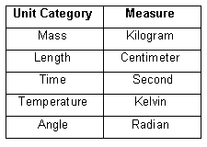
Units of Measure – Internal Units
Internally, Inventor uses a consistent set of units regardless of what the user has specified as the document default
The precision is always double-precision floating point, regardless of the precision specified by the user
Internal units used by Inventor for the various types of units

Slide 24
Units of Measure - Verifying User Input
Private m_oUOM As UnitsOfMeasure
Private Sub UserForm_Initialize()
' get the UnitsOfMeasure of the current document
m_oUOM = _InvApplication.ActiveDocument.UnitsOfMeasure
End Sub
Private Sub TextBox1_Change()
' Check if the input string defines a valid length.
If Not m_oUOM.IsExpressionValid(TextBox1.Text, UnitsTypeEnum.kDefaultDisplayLengthUnits) Then
' The string is not valid so change the text color to red.
TextBox1.ForeColor = Drawing.Color.Red
Else
' The string is valid so change the text color to the default color.
TextBox1.ForeColor = Drawing.Color.Black
End If
End Sub

Slide 25
Units of Measure - Using User Input
' Get the real value of the input string.
Dim dValue As Double
dValue = m_oUOM.GetValueFromExpression(txtInput.Text, _
UnitsTypeEnum.kDefaultDisplayLengthUnits)
' Compare the value with the length of a sketch line.
If System.Math.Abs(oSketchLine.Length - dValue) < 0.00001 Then
MsgBox("Line is equal to the input value")
Else
MsgBox("Line is not equal to the input value")
End If

Slide 26
Units Of Measure - Displaying Values
Private Sub TestLength()
ShowLength(6.5)
End Sub
Private Sub ShowLength(ByVal dLength As Double)
' Get the string representation of the length.
Dim strLength As String
strLength = m_oUOM.GetStringFromValue(dLength, _
UnitsTypeEnum.kDefaultDisplayLengthUnits)
MsgBox("The Length is: " & strLength)
End Sub

Slide 27
Component Definition
For part and assembly documents the ComponentDefinition objects provide access to the information that defines the part or assembly.
Drawings don’t have a ComponentDefinition.

Slide 28
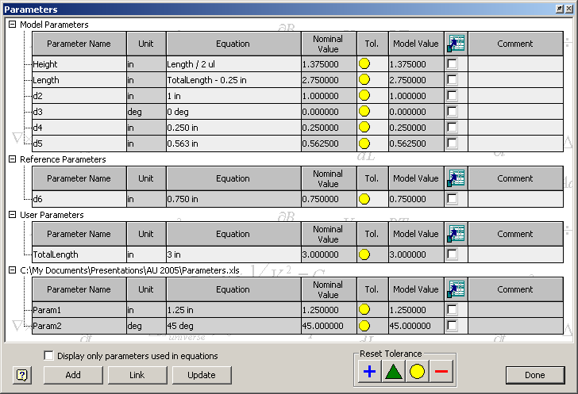
Parameters - In the User Interface

Slide 29
Parameters – In the API
' Get the Parameters collection object.
Dim oParameters As Parameters = _
_InvApplication.ActiveDocument.ComponentDefinition.Parameters

Slide 30
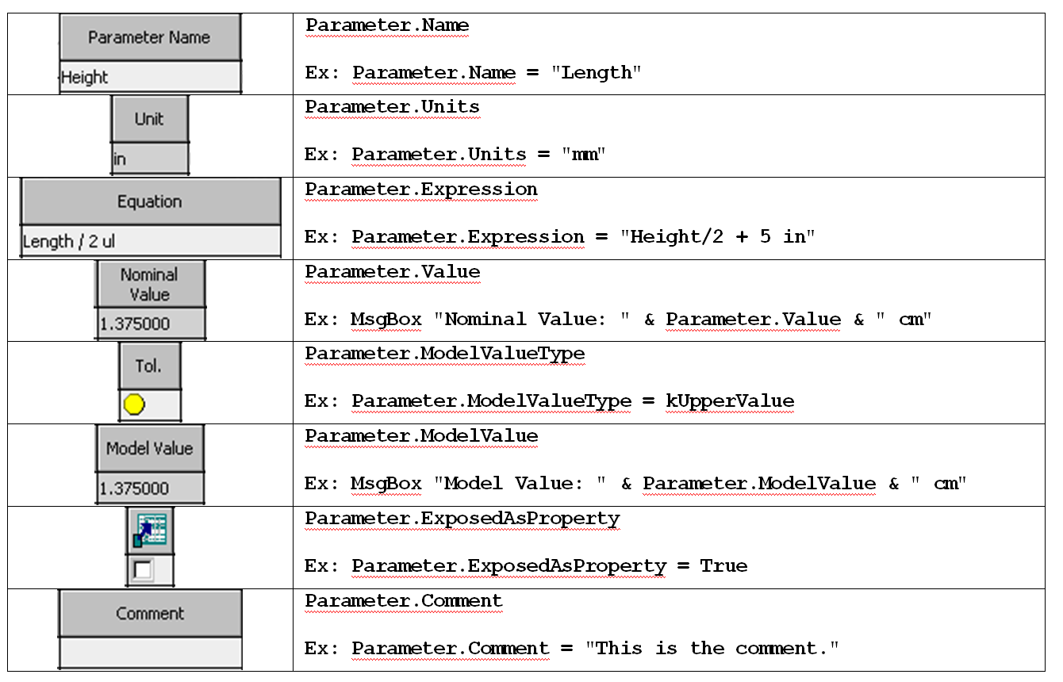
Parameters – UI vs. API

Slide 31
Parameters - Setting Values
Public Sub SetParameter()
' Get the Parameters object. Assumes a part or assembly document is active.
Dim oParameters As Parameters
oParameters = _InvApplication.ActiveDocument.ComponentDefinition.Parameters
' Get the parameter named "Length".
Dim oLengthParam As Parameter
oLengthParam = oParameters.Item("Length")
' Change the equation of the parameter.
oLengthParam.Expression = "3.5 in"
' Update the document.
_InvApplication.ActiveDocument.Update()
End Sub

Slide 32
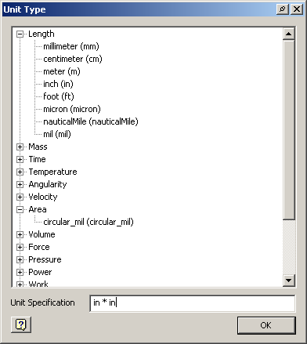
Parameters - Units
The Unit property can be set using either a String or a value from UnitsTypeEnum.
The UnitsTypeEnum is an API equivalent to the pre-defined unit types displayed in the Unit Type dialog.
Setting the unit type using a String is the same as defining a unit in the Unit Type dialog and allows you to define custom unit types by combining known unit types.

Slide 33
Parameters - Values
Unlike in the user-interface, the API allows you to directly set the value of a parameter.
The Value property sets the actual value of the parameter and will overwrite any existing equation.
In API, Parameter values are always defined using internal units.
Length – Centimeters
Angle – Radians
π radians = 180 degrees
π = Atn(1) * 4

Slide 34
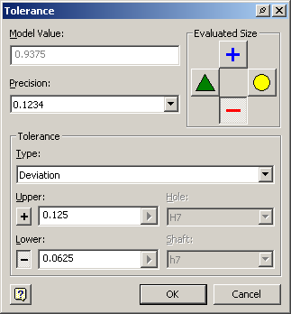
Parameters - Tolerances
Tolerances can be defined for Model parameters.
The Tolerance object exposes functionalities of the Tolerance dialog.
The SetToDefault, SetToDeviation, SetToLimits, etc… methods of the Parameter object allow you to define the parameter’s tolerance.
Call oParam.Tolerance.SetToDeviation("0.125 in", “-0.0625 in")
Call oParam.Tolerance.SetToDeviation(2.54 / 8, -2.54 / 16)
The ModelValueType property sets which tolerance to use when computing the model value.
The Precision property sets the number of decimal places to display.
The SetAllToMax, SetAllToMedian, SetAllToMin, SetAllToNominal methods of the Parameters object provides the equivalent of the Parameter dialog’s “Reset Tolerance”.

Slide 35
Parameters – Parameter Types
The Parameters collection returns all Parameter objects regardless of the type.
The ModelParameters, ParameterTables, ReferenceParameters, and UserParameters objects provide access to specific types of parameters.

Slide 36
Parameters – Parameter Creation
Parameters are created by using methods on the collection for the specific type of parameter you want to create.
In the user-interface you can only create user parameters. All other types are indirectly created as a result of other actions.
In the API you can directly create user, model, and reference parameters.
TableParameters are created by importing an Excel worksheet.
Parameters are created using either the AddByExpression or AddByValue methods.

Slide 37
Creating Parameters - Examples
‘ add user parameters
Dim oUserParams As UserParameters
oUserParams = oCompDef.Parameters.UserParameters
Dim oParam As Parameter
oParam = oUserParams.AddByExpression("NewParam1", "3", _
UnitsTypeEnum.kInchLengthUnits)
oParam = oUserParams.AddByExpression("NewParam1", "3", "in")
oParam = oUserParams.AddByExpression("NewParam2", "3", _ UnitsTypeEnum.kDefaultDisplayLengthUnits)
oParam = oUserParams.AddByExpression("NewParam2", "3 in", _ UnitsTypeEnum.kDefaultDisplayLengthUnits)
oParam = oUserParams.AddByValue("NewParam3", 3 * 2.54, _
UnitsTypeEnum.kDefaultDisplayLengthUnits)
Notes:
'Parameters Creation VB.Net
Public Sub CreateUserParams()
Dim oDoc As PartDocument
oDoc = _InvApplication.ActiveDocument
Dim oUserParams As UserParameters
oUserParams = oDoc.ComponentDefinition.Parameters.UserParameters
Dim oNewParam As Parameter
oNewParam = oUserParams.AddByExpression("NewParam1", "3", UnitsTypeEnum.kInchLengthUnits)
oNewParam = oUserParams.AddByExpression("NewParam1_2", "3", "in")
oNewParam = oUserParams.AddByExpression("NewParam2", "5", UnitsTypeEnum.kDefaultDisplayLengthUnits)
oNewParam = oUserParams.AddByExpression("NewParam2_2", "5 in", UnitsTypeEnum.kDefaultDisplayLengthUnits)
oNewParam = oUserParams.AddByValue("NewParam3", 3 * 2.54, UnitsTypeEnum.kDefaultDisplayLengthUnits)
'Set Param3 not deletable from the UI
oNewParam.DisabledActionTypes = ActionTypeEnum.kDeleteAction
Dim oGroup As CustomParameterGroup
oGroup = oDoc.ComponentDefinition.Parameters.CustomParameterGroups.Add("CustomGroup", "intCustGrpName")
oGroup.Add(oNewParam)
End Sub

Slide 38
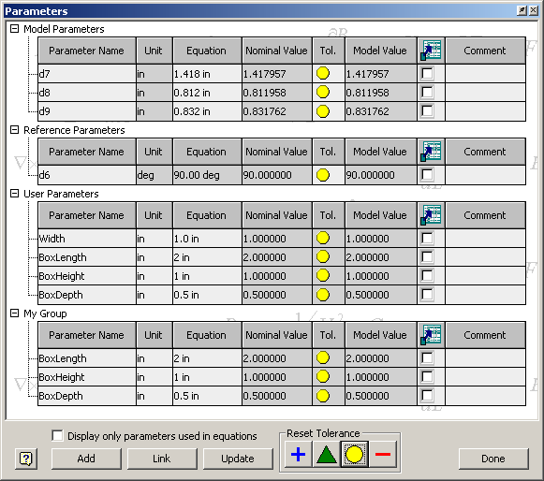
Parameters – API Only Functionality
Creation of Model and Reference parameters.
Delete unused Model and Referenced Parameters.
DisabledActionTypes – Prohibit deletion of user parameters.
Dependents, DrivenBy – Provides dependency information between parameters.
Creation of custom parameter groups.
Change the type of a parameter.
Model to Reference
Reference to Model
User to Model
User to Reference

Slide 39
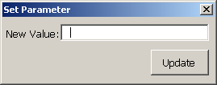
Lab: Parameters and UOM
Interactively create a simple part that contains a parameter named “Length” to control the size of the part.
Create a .Net program that contains a dialog that looks similar to the one below.
The end-user should have created a parameter named “Length” which is a numeric. By this code, he is able to enter any valid expression. The text field should provide feedback when an invalid expression has been defined.
When the “Update” button is pressed the entered value should be assigned to the parameter.

Slide 40

Notes:
Thank you!
Questions?

